Slide 1

Pushdown Automata
Chapter 12

Slide 2
Recognizing Context-Free Languages
Two notions of recognition:
(1) Say yes or no, just like with FSMs
(2) Say yes or no, AND
if yes, describe the structure
a + b * c

Slide 3
Just Recognizing
  We need a device similar to an FSM except that it needs more power.
  The insight: Precisely what it needs is a stack, which gives it an unlimited amount of memory with a restricted structure.
  Example: Bal (the balanced parentheses language)
  (((()))

Slide 4
Before Defining Our PDA
It’s defined as nondeterministic
  DFSM = NDFSM = Regular language
  NDPDA = Context-free language > DPDA
  In contract to regular languages, where nondeterminism is a convenient design tool.
  Some context-free languages do not have equivalent DPDA to recognize them.

Slide 5
Before Defining Our PDA
Alternative equivalent PDA definitions
Our version is sometimes referred to as “Generalized extended PDA” (GPDA), a PDA which writes an entire string to the stack or removes an entire string from the stack in one step.
  In some definition, M may pop only a single symbol but it may push any number of them.
  In some definition, M may pop and push only a single symbol.
In our version, M accepts w only if, when it finishes reading w, it is in an accepting state and its stack is empty.
  Finite state acceptance: when it finishes reading w, it is in an accepting state, regardless the content of the stack.
  Empty stack acceptance: when it finishes reading w, the stack is empty, regardless of the state M is in.
We do not use “bottom of stack marker” but some do.
All of these are provably equivalent as they recognize the same L.
Note: JFLAP uses a stack marker, either finite state or empty stack acceptance.
So, the examples in the book may not run well in JFLAP.

Slide 6
Before Defining Our PDA
Alternative non-equivalent variants
  Variation 1 (Tag systems or Post machines): FSM + a first-in, first-out (FIFO) queue (instead of a stack)
  Variation 2: FSM + two stacks
  Both are more powerful, equivalent to Turing machines.

Slide 7
Definition of a (Nondeterministic) Pushdown Automaton
  M = (K, Σ, Γ, Δ, s, A), where:
  K is a finite set of states
  Σ is the input alphabet
  Γ is the stack alphabet
  s ∈ K is the initial state
  A ⊆ K is the set of accepting states, and
  Δ is the transition relation. It is a finite subset of
  (K × (Σ ∪ {ε}) × Γ*) × (K × Γ*)
  state input or ε string of state string of
  symbols symbols
  to pop to push
  from top on top
  of stack of stack

Slide 8
Transition
  (K × (Σ ∪ {ε}) × Γ*) × (K × Γ*)
  state input or ε string of state string of
  symbols symbols
  to pop to push
  from top on top
  of stack of stack
((q₁, c, γ₁), (q₂, γ₂))
If c matches the input and γ₁ matches
the current top of the stack, the transition
From q₁ to q₂ can be taken.
Then, c will be removed from the input, γ₁ will be popped from the stack, and γ₂ will be pushed onto it.
M cannot peek at the top of the stack without popping
If c = ε, the transition can be taken without consuming any input
If γ₁ = ε, the transition can be taken without checking the stack or popping anything. Note: it’s not saying “the stack is empty”.
If γ₂ = ε, nothing is pushed onto the stack when the transition is taken.
C / γ₁ / γ₂
q₁
q₂
Notes:
Notations may vary, e.g., in JFLAP, C , γ₁ ; γ₂

Slide 9
Definition of a Pushdown Automaton
  A configuration of M is an element of K × Σ* × Γ*.
  The initial configuration of M is (s, w, ε).

Slide 10
Manipulating the Stack
  c will be written as cab
  a
  b
  If c₁c₂…c_{n} is pushed onto the stack: rightmost first
  c₁
  c₂
  c_{n}
  c
  a
  b
  c₁c₂…c_{n}cab

Slide 11
Yields
Let c be any element of Σ ∪ {ε},
Let γ₁, γ₂ and γ be any elements of Γ*, and
Let w be any element of Σ*.
Then:
(q₁, cw, γ₁γ) |-_{M} (q₂, w, γ₂γ) iff ((q₁, c, γ₁), (q₂, γ₂)) ∈ Δ.
Let |-_{M}* be the reflexive, transitive closure of |-_{M}
C₁ yields configuration C₂ iff C₁ |-_{M}* C₂

Slide 12
Nondeterminism
If M is in some configuration (q₁, s, γ) it is possible that:
● Δ contains exactly one transition that matches.
● Δ contains more than one transition that matches.
● Δ contains no transition that matches.

Slide 13
Accepting
Recall: a path is a maximal sequence of steps from the start configuration
M accepts a string w iff there exists some path that accepts it.
For PDA, (q, ε, ε) where q ∈ A is an accepting configuration.
M halts upon acceptance.
Other paths may:
● Read all the input and halt in a nonaccepting state,
● Read all the input and halt in an accepting state with the stack not empty,
● Reach a dead end where no more input can be read.
● Loop forever and never finish reading the input, or
The language accepted by M, denoted L(M), is the set of all strings accepted by M.
M rejects a string w iff all paths reject it.
It is possible that, on input w ∉L(M), M neither accepts nor rejects. In that case, no path accepts and some path does not reject.

Slide 14
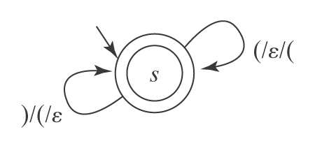
A PDA for Balanced Parentheses
M = (K, Σ, Γ, Δ, s, A), where:
K = {s} the states
Σ = {(, )} the input alphabet
Γ = {(} the stack alphabet
A = {s}
Δ contains:
((s, (, ε), (s, ( ))
((s, ), ( ), (s, ε))

Slide 15
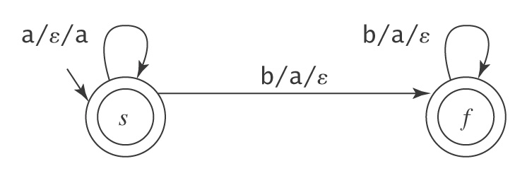
A PDA for A^{n}B^{n} = {a^{n}b^{n}: n ≥ 0}

Slide 16
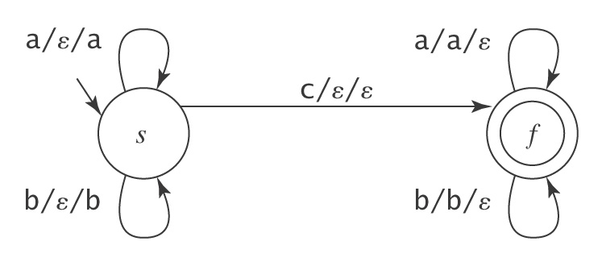
A PDA for {wcw^{R}: w ∈ {a, b}*}
M = (K, Σ, Γ, Δ, s, A), where:
K = {s, f} the states
Σ = {a, b, c} the input alphabet
Γ = {a, b} the stack alphabet
A = {f} the accepting states
Δ contains: ((s, a, ε), (s, a))
((s, b, ε), (s, b))
((s, c, ε), (f, ε))
((f, a, a), (f, ε))
((f, b, b), (f, ε))

Slide 17
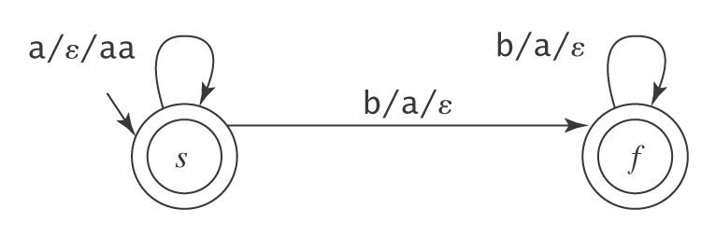
A PDA for {a^{n}b^{2n}: n ≥ 0}

Slide 18
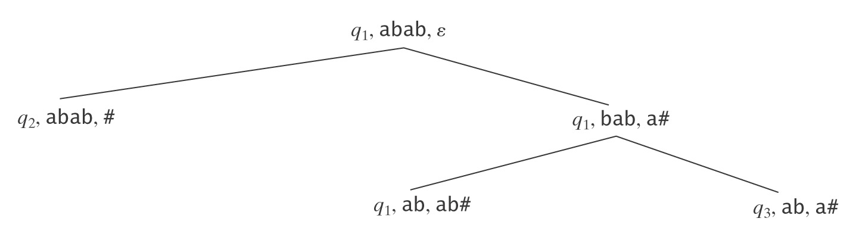
Exploiting Nondeterminism
A PDA M is deterministic iff:
  Δ_{M} contains no pairs of transitions that compete with each other, and
  whenever M is in an accepting configuration it has no available moves.
  Unfortunately, unlike FSMs, there exist NDPDA s for which no equivalent DPDA exists.
Previous examples are DPDA, where each machine followed only a single computational path.
But many useful PDAs are not deterministic, where from a single configuration there exist multiple competing moves.
  Easiest way to envision the operation of a NDPDA is as a tree
  The state, the stack, and the remaining input can be different along different paths, so, impossible to simulate all paths in parallel, as for NDFSMs.

Slide 19
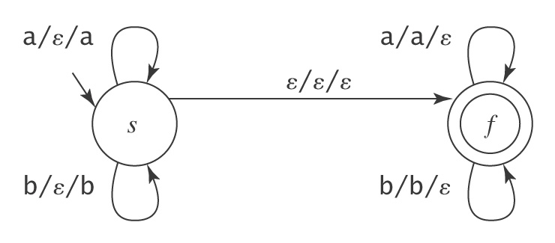
A PDA for PalEven ={ww^{R}: w ∈ {a, b}*}
S → ε
S → aSa
S → bSb
A PDA:
Even length palindromes

Slide 20
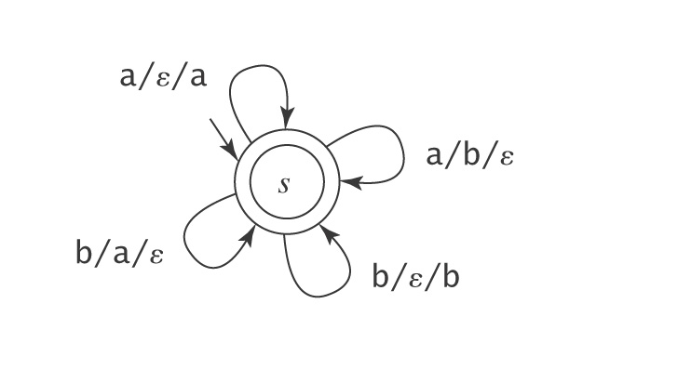
A PDA for {w ∈ {a, b}* : #_{a}(w) = #_{b}(w)}
Equal numbers of a’s and b’s
Question: why is it non-deterministic?
Question: can we make it deterministic?
Notes:
a/ε/a and a/b/ε
The meaning of ε
Slide 8, do not mean stack is empty, but do not need to check
----
With the help of bottom of stack marker

Slide 21
The Power of Nondeterminism
Consider A^{n}B^{n}C^{n} = {a^{n}b^{n}c^{n}: n ≥ 0}.
PDA for it?
Now consider L = ¬ A^{n}B^{n}C^{n}. L is the union of two languages:
1. {w ∈ {a, b, c}* : the letters are out of order}, and
2. {a^{i}b^{j}c^{k}: i, j, k ≥ 0 and (i ≠ j or j ≠ k)} (in other words,
unequal numbers of a’s, b’s, and c’s).

Slide 22
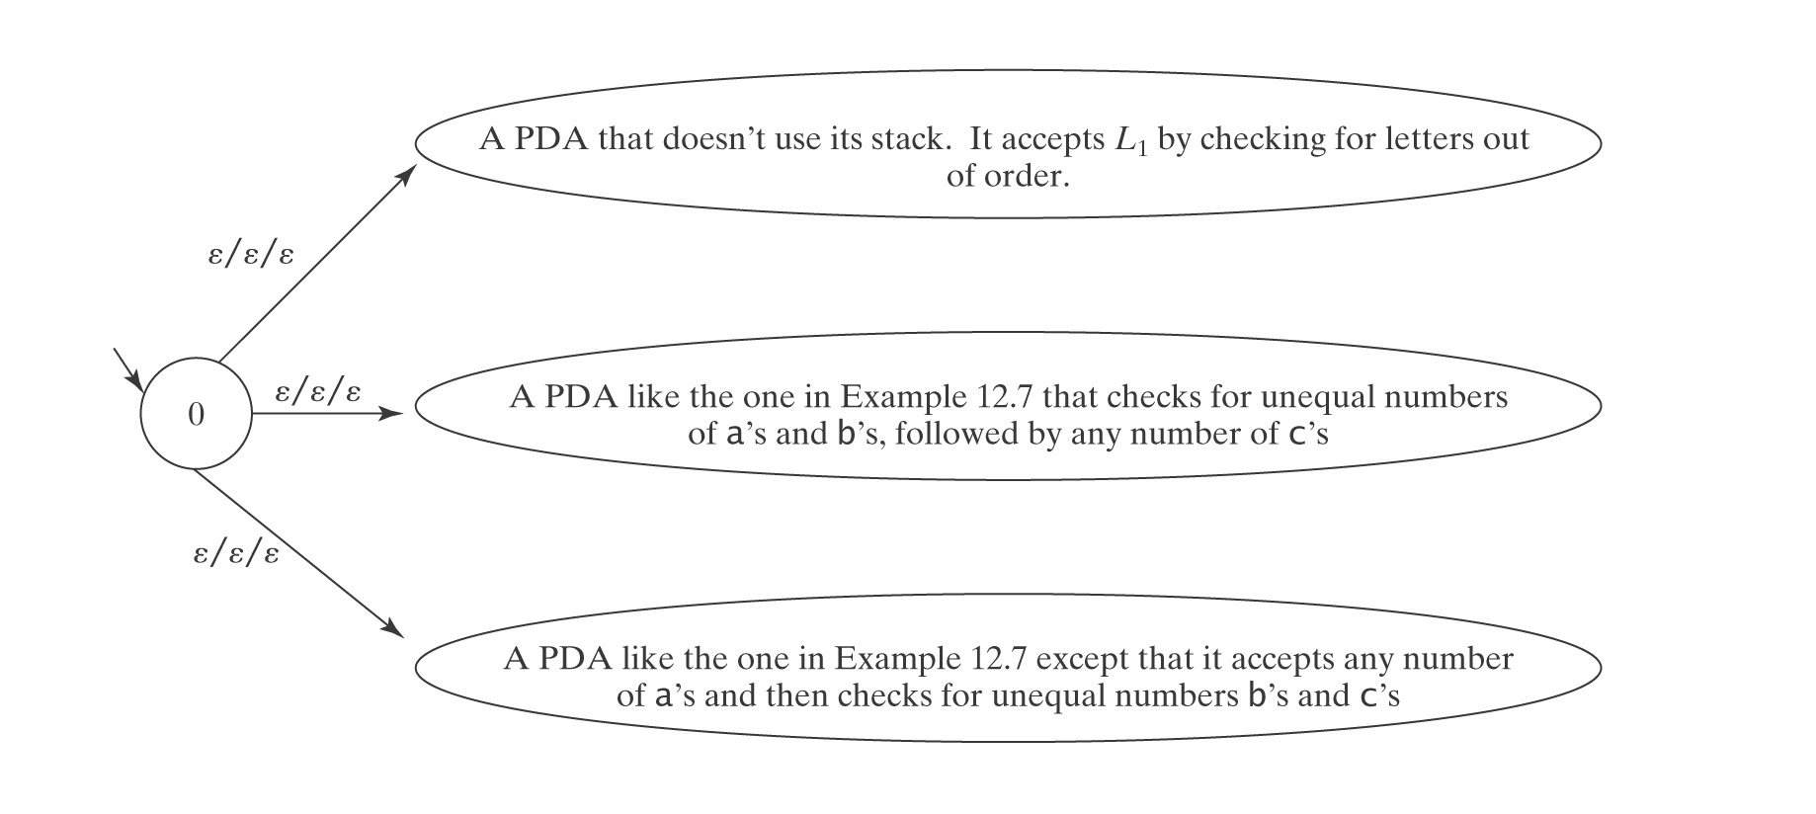
A PDA for L = ¬A^{n}B^{n}C^{n}
Example 12.7 is the next.
Question: Why can’t we use the power of nondeterminism for A^{n}B^{n}C^{n} as well?
e.g., sublanguage 1 = A^{n}B^{n}; sublanguage2 = B^{n}C^{n}
Notes:
OR vs. AND

Slide 23
Are the Context-Free Languages Closed Under Complement?
¬A^{n}B^{n}C^{n} is context free.
If the CF languages were closed under complement, then
¬¬A^{n}B^{n}C^{n} = A^{n}B^{n}C^{n}
would also be context-free.
But we will prove that it is not.

Slide 24
More on Nondeterminism
Accepting Mismatches
L = {a^{m}b^{n} : m ≠ n; m, n > 0}
Start with the case where n = m:
b/a/ε
a/ε/a
b/a/ε
1
2
Hard to build a machine that looks for something negative, like ≠
Idea: break L into two sublanguages:
{a^{m}b^{n} : 0 < m < n} and {a^{m}b^{n} : 0 < n < m}
● If stack and input are empty, halt and reject.
● If stack is empty but input is not (m < n) (accept)
● If input is empty but stack is not (m > n) (accept)
Notes:
No, in PDA, by our definition, acceptance = halting in accepting state + empty stack
Changing a rejecting state to an accepting state does not guarantee acceptance at that state.

Slide 25
More on Nondeterminism
Accepting Mismatches
L = {a^{m}b^{n} : m ≠ n; m, n > 0}
b/a/ε
a/ε/a
b/a/ε
1
2
● If input is empty but stack is not (m < n) (accept):
a/ε/a
b/a/ε
ε/a/ε
b/a/ε
ε/a/ε
1
2
3

Slide 26
More on Nondeterminism
Accepting Mismatches
L = {a^{m}b^{n} : m ≠ n; m, n > 0}
b/a/ε
a/ε/a
b/a/ε
1
2
● If stack is empty but input is not (m > n) (accept):
b/a/ε
b/ε/ε
a/ε/a
b/a/ε
b/ε/ε
1
2
4

Slide 27
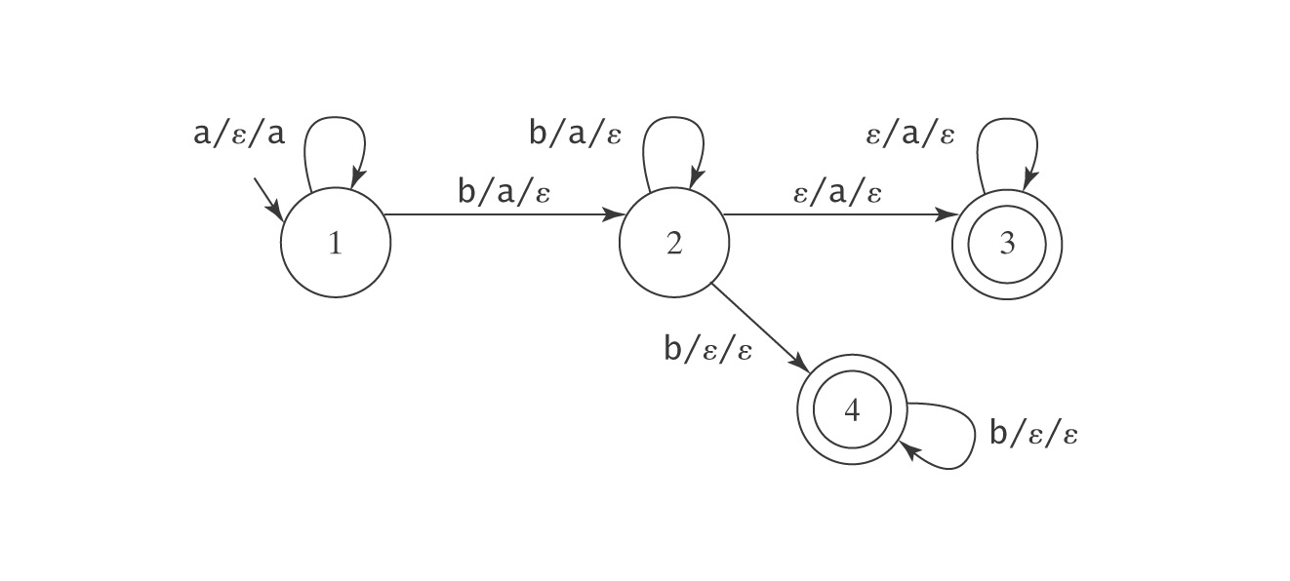
Putting It Together
L = {a^{m}b^{n} : m ≠ n; m, n > 0}
Node 2 is nondeterministic.
Note:
2 to 4 is a transition that should be taken only if the stack (of a’s) is empty (if we can detect bottom of stack …)
2 to 3 is a transition that should be taken only if the input stream is empty (if we can detect end of string …)

Slide 28
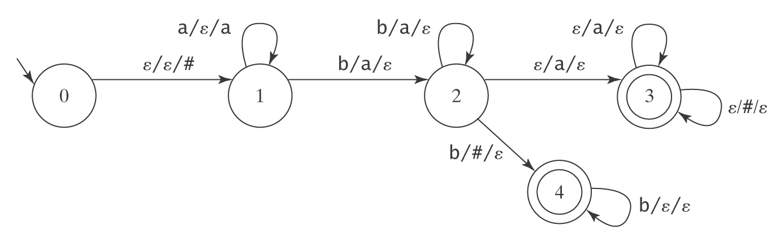
Reducing Nondeterminism
● Use a bottom-of-stack marker: #

Slide 29
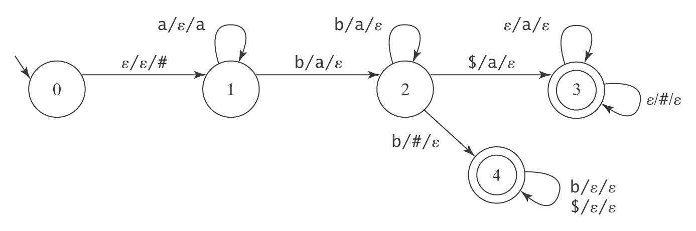
Continue Reducing Nondeterminism
● Use an end-of-string marker: $

Slide 30
PDAs and Context-Free Grammars
Theorem: The class of languages accepted by PDAs is exactly the class of context-free languages.
Recall: context-free languages are languages that
can be defined with context-free grammars.
Restate theorem:
Can describe with context-free grammar
Can accept by PDA

Slide 31
Proof
Lemma: Each context-free language is accepted by some PDA.
Lemma: If a language is accepted by a PDA M, it is context-free (i.e., it can be described by a context-free grammar).
Proof by construction

Slide 32
Are the Context-Free Languages Closed Under Complement?
¬A^{n}B^{n}C^{n} is context free.
If the CF languages were closed under complement, then
¬¬A^{n}B^{n}C^{n} = A^{n}B^{n}C^{n}
would also be context-free.
But we will prove that it is not.

Slide 33
Nondeterminism and Halting
1. There are context-free languages for which no deterministic PDA exists.
2. It is possible that a PDA may
● not halt,
● not ever finish reading its input.
However, for an arbitrary PDA M, there exists M’ that halts and L(M’) = L(M)
3. There exists no algorithm to minimize a PDA. It is undecidable whether a PDA is minimal.

Slide 34
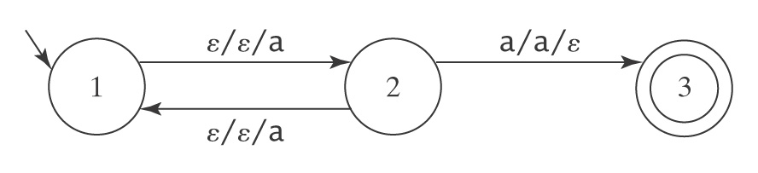
Nondeterminism and Halting
It is possible that a PDA may not halt
Let Σ = {a} and consider M =
The path (1, a, ε) |- (2, a, a) |- (3, ε, ε) causes M to accept a. L(M) = {a}
On any other input except a:
● M will never halt because of one path never ends and none of the paths accepts.
Note: the same situation for NDFSM.
Notes:
Section 12.4, on page 12.
Seems lots of errors. E.g., “We’ll say that M halts on w iff every computation of M on w halts”
But if M accepts w if one computation accepts w. although others may not halt, M still halts since M accepts w.

Slide 35
Comparing Regular and
Context-Free Languages
  Regular Languages Context-Free Languages
  ● regular exprs.
  or
  regular grammars ● context-free grammars
  ● recognize ● parse
  ● = DFSMs ● = NDPDAs

